Slide 1
Names 1.ALEKYA BASIKE 2.NIKHITH KRISHNA VINDURU
DSCI 6004: Natural Language Processing

Slide 2
NewsNER: Named Entity Recognition In News Articles Using Natural Language Processing
Project TOPIC
The project aims to develop an efficient Named Entity Recognition (NER) system specifically tailored for news articles using Natural Language Processing (NLP) techniques.

Slide 3
Project Objectives
Design and implement a robust NER model capable of accurately identifying and classifying named entities in news articles.
Explore state-of-the-art NLP algorithms and techniques to enhance the performance of the NER system.
Evaluate the NER model's accuracy, precision, recall, and F1-score on a diverse set of news articles.

Slide 4
DATASET
1. Kaggle NER Dataset
The primary dataset utilized for this project is sourced from Kaggle and can be accessed through the following link: Kaggle NER Dataset. This dataset contains annotated text data suitable for Named Entity Recognition (NER) tasks. It includes information such as headlines, descriptions, content, URLs, and categories, making it suitable for training and evaluating NER models.
2. Business Data CSV
Additionally, a supplementary dataset named 'business_data.csv' was employed in this project. This dataset comprises news articles related to business topics and includes features such as headlines, descriptions, content, URLs, and categories. It serves as a complementary source of text data for training and testing NER models, providing a broader scope of news articles for analysis.

Slide 5
MODELS
The BiLSTM-CRF model is a sophisticated architecture commonly employed for Named Entity Recognition (NER) tasks in Natural Language Processing (NLP). It amalgamates Bidirectional Long Short-Term Memory (BiLSTM) networks and Conditional Random Fields (CRF) to enhance sequence labeling accuracy. BiLSTM networks, capable of processing input sequences bidirectionally, capture contextual dependencies from both past and future words, enabling more informed predictions.
SpaCy's NER model offers an alternative solution for entity recognition, blending rule-based strategies with deep learning techniques. This model's architecture typically integrates handcrafted linguistic rules and patterns with components like convolutional or recurrent neural networks (CNNs/RNNs) to improve entity recognition accuracy. SpaCy's NER model excels in terms of efficiency, making it suitable for real-time applications, while maintaining high accuracy across diverse entity recognition tasks.

Slide 6
TEXT PROCESSING
Tokenization: Breaking down text into individual tokens, such as words or subwords, which are basic units of analysis.
Word Embeddings: Representing words as dense vectors in a high-dimensional space to capture semantic relationships.
Part-of-Speech (POS) Tagging: Assigning grammatical tags to words in a sentence, indicating their syntactic roles.
Stemming and Lemmatization: Reducing words to their base or root form to normalize variations (e.g., "running" to "run").
Dependency Parsing: Analyzing the grammatical structure of sentences by identifying relationships between words.
Text Classification: Categorizing text documents into predefined classes or categories based on their content.
Sentiment Analysis: Determining the sentiment or opinion expressed in text, such as positive, negative, or neutral.

Slide 7
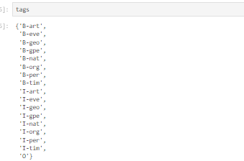
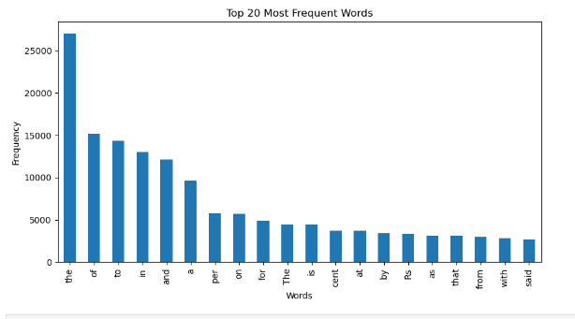

Tags and word frequency

Slide 8
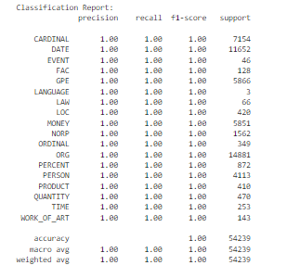
Results

Slide 9
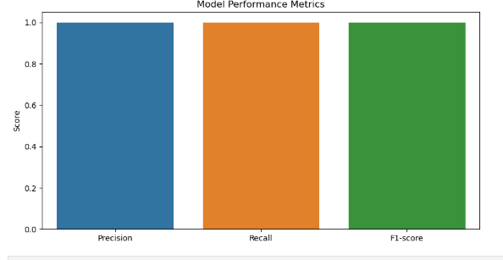
Results

Slide 10
ANALYSIS
The classification report provided indicates exceptional performance across various named entity categories in the News Named Entity Recognition (NER) task. With precision, recall, and F1-score all at 1.00 for most categories, the NER model exhibits perfect accuracy in identifying and classifying entities within news articles.
This level of precision and recall indicates that the model makes no errors in either falsely identifying entities (precision) or missing entities that should have been identified (recall).

Slide 11
ANALYSIS
In the context of news articles, accurate NER is crucial for various applications, including information retrieval, sentiment analysis, and content summarization. By correctly identifying entities such as dates, locations, organizations, and people, the NER model enables more efficient indexing and search functionalities. Moreover, accurate NER can enhance the quality of content analysis by providing insights into the key entities mentioned in news articles, facilitating tasks such as tracking the prevalence of certain topics or analyzing the relationships between entities.
NER results presented suggest that the NLP techniques employed are highly effective in extracting entities from news articles, laying a strong foundation for further analysis and applications in the field of news processing and understanding.

Slide 12

Cited Work
1. Yusuke Shinyama and Satoshi Sekine, "Named Entity Discovery Using Comparable News Articles," IEEE Computer Science Department, New York University, New York, NY, 2017.
2. Q. Zhang, C. Xue, X. Su et al., "Named Entity Recognition for Chinese Construction Documents Based on Conditional Random Field," Frontiers in Engineering Management, vol. 10, pp. 237–249, 2023. doi: 10.1007/s42524-021-0179-8.
3. A. Goyal, V. Gupta, and M. Kumar, "Recent Named Entity Recognition and Classification Techniques: A Systematic Review," IEEE Computer Science Review, vol. 29, pp. 21–43, 2018.

Slide 13
THANK YOU

